Slide 1
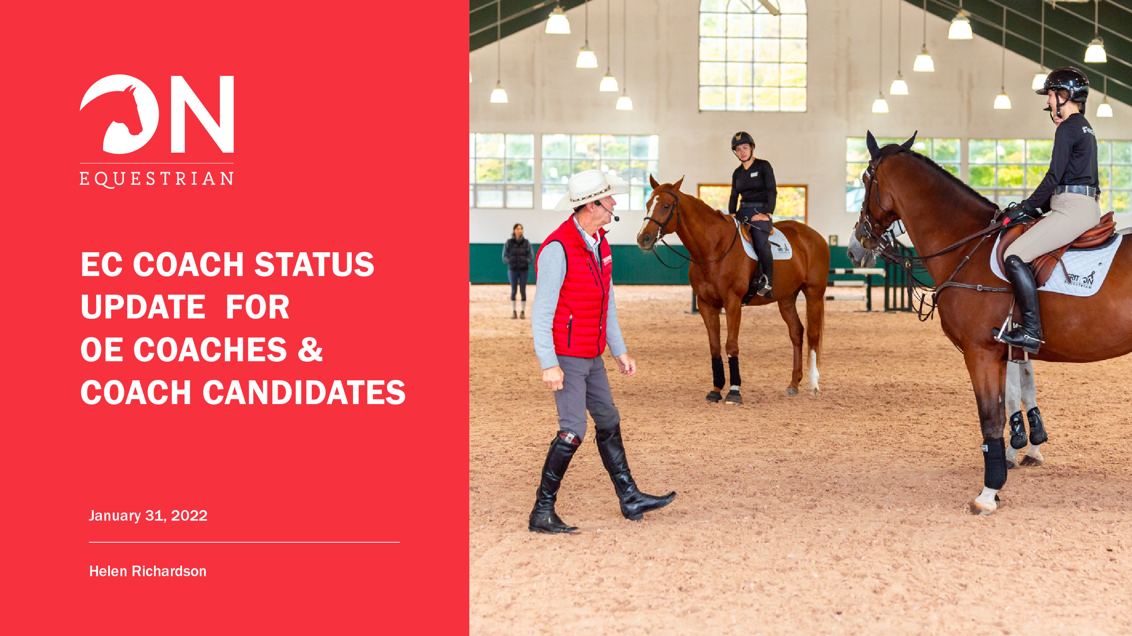
Coaching AT EC CompetitionS - 2024/25
February 24, 2024

Slide 2

Coaching at EC Competition - 2024
Notes:
So what’s required for 2024 at EC Sanctioned shows? This includes Bronze, Silver, Gold and Platinum sanctioned competitions. All coaches who are coaching at competitions need to have EC Licensed Coach Status. We’re going to have a look at what that means, and what you need to do now, before show season begins.

Slide 3


Coach Status vs Coach Certification
Coach Status
A Coach Status verifies that coaches are insured, screened and trained in all necessary safety measures. A Status provides recognition as an active coach, whether you are certified or not.
$80.00
$200.00*
*15% discount for NCCP Certified Coaches
Coach Certification
Coach Certification is the formal credentialing process that includes training and formal evaluation through independent assessment of coaching competencies and ongoing professional development requirements.
Notes:
There are 2 programs we need to discuss in relation to EC’s coaching requirements – Coach Status and Coach Certification.

Slide 4


Coach Status
Fee | $80.00 annually | $200.00 annually * 15% discount for EC/NCCP coaches
Safe Sport | Courses are valid for up to three (3) years EC Concussion Education (or equivalent) EC Fostering Healthy Equestrian Environments (or equivalent)
Screening | Criminal Record/Enhanced Police Information Check (valid for three years) Vulnerable Sector Check (completed once only; exempt if born after February 28, 1986) EC Screening Disclosure (valid for 12 months)
References | One (1) letter of reference from equestrian colleague, client, or parent of minor–aged client | Two (2) letters of reference from equestrian colleagues, clients or parents of minor-aged clients
First Aid Training | Standard First Aid with CPR (minimum Level C) Min. 50% in-person delivery and meet OHS standards provincially
Insurance | Minimum $2,000,000 Commercial General Liability Minimum $100,000 Professional Liability Insurance
Certification or Equivalent | Optional | Required

Slide 5


Coach Status – Accepted Certifications
Certifications & Recognized Equivalents
Active NCCP: Up to date with professional development (PD) requirements (five-year cycle)
EC Recognized Non-NCCP Coach Certification
  International Group of Equestrian Qualifications (IGEQ)
  Canadian Therapeutic Riding Association (CanTRA)
  Canadian Pony Club (Level A only)
  Certified Horsemanship Association (CHA) English and Western
  Provincial Vaulting Trainer Certification
Post-Secondary Degree or Diploma
  Equine Sciences/Agriculture
  Teacher or Coach Education
  Physical Education
Certification Exemption (based on 20 years of experience in the field, progressive PD requirements)
Notes:
How can you complete the requirement for certification?

Slide 6
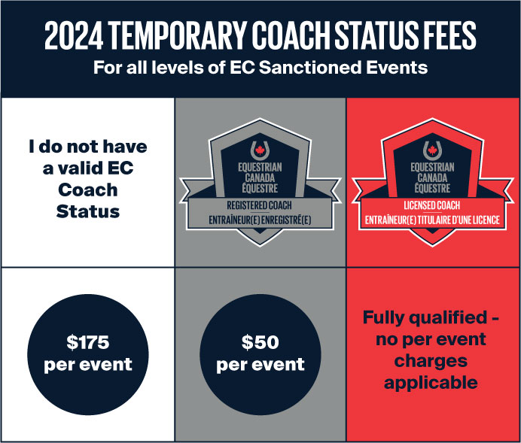
Coach Status – On the Field of Sport
Coach Status Requirements 2024
Canadian residents coaching athletes at EC-sanctioned competitions must meet minimum Coach Status requirements.
For those who do not meet the minimum requirements, Temporary Coach Status will be available directly through MyEC. Funds collected from Temporary Coach Status will be directed into supporting coaches and NCCP programming.

Slide 7
Coach Status – Roles & Responsibilities
Competition Organizers: ensure ALL entries include information regarding COACH NAME and COACH EC NUMBER
EC Officials: Coach Status is not required to be present in the warm-up ring or interact with athletes at the ringside. EC Officials are empowered to validate Coach Status (e.g. when a coach-related privilege is requested, navigating conflict).

Slide 8
Coach Status – Self-Coached Athletes
Athletes who attend a competition without a Coach.
By entering one’s own name and EC Sport License in the entry form fields designated for coaching information, an individual is declaring themself to be self-coached.
Athletes under 18 years of age may declare themselves as self-coached. Entry forms for minor children require the parent/guardian signature.
Entry into an EC-sanctioned competition constitutes an agreement to be bound by the rules of EC. Inaccurate information on entry forms may invalidate points and are subject to further EC penalties.

Slide 9
EC NCCP Certification
Notes:
Now we’ll discuss the certification options

Slide 10
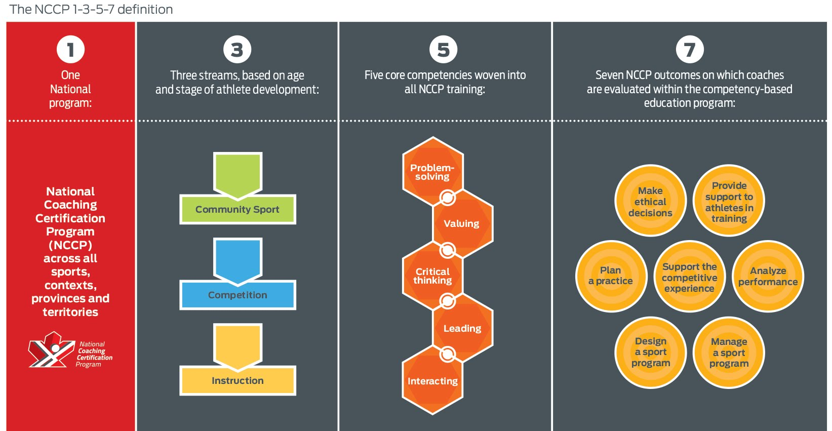
EC NCCP Coach Certification
Notes:
1 Min
Introduce the National Coaching Certification Program
(NCCP):
o 1 national program (across 68 sports, contexts and provinces and territories)
o 3 streams (based on age and stage of athlete development)
o 5 core competencies (woven into all NCCP training)
o 7 NCCP outcomes (on which coaches are evaluated within the competency-based education program)

Slide 11
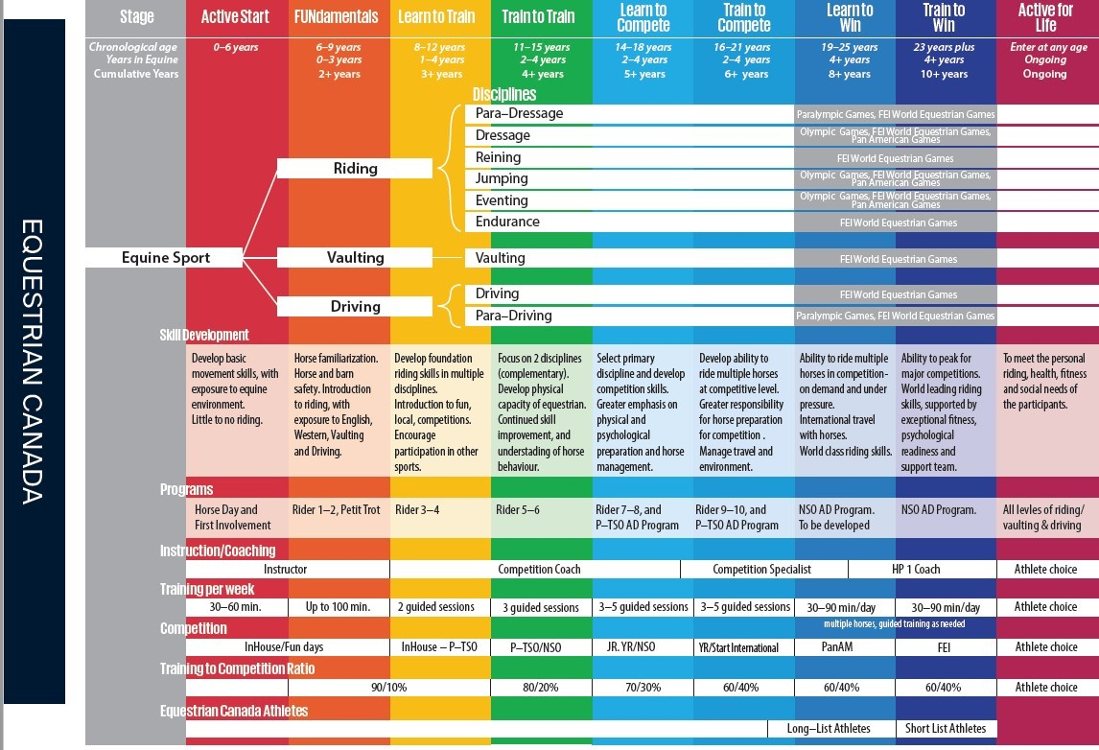
OVERALL CONTEXT
Report on athlete progress throughout program
https://equestrian.ca/programs-services/lted
Notes:
The NCCP Coaching program is designed to educate coaches for training HUMAN athletes at various stages of development. Knowing what stage of development your athletes, or the ones you want to coach, will determine which context of certification is appropriate for you.
Equestrian Canada’s programs are designed around the Long Term Equestrian Development plan EC has, which was built in cooperation with Sport Canada and Sport for Life.

Slide 12



EC NCCP Instructor
Admission | LTED Athletes | Disciplines / Contexts | Outcomes Evaluated
Be 16 years of age Active PTSO membership in good standing (purchased through home PTSO first) Active EC Sport License in good standing Active EC Registered or Licensed Coach status in good standing NCCP Make Ethical Decisions online course and evaluation * LTRD – English, Level 6 OR LTRD – Western Level 4 OR LTRD – Driving OR Pony Club C2 (all elements with evidence) | Active Start Fundamentals | English Instructor English Instructor with Jumping Western Instructor Driving Instructor Saddle Seat Instructor | Plan an Equestrian Practice Provide Support to Athletes in Training Analyze Beginner Equestrian Performance Make Ethical Decisions
Notes:
*Candidates may challenge the online evaluation without completing the classroom-based component. Those who fail to achieve a minimum passing grade of 75% after a maximum two (2) challenge attempts must complete the online course and evaluation in their entirety.
Instructors can hold Amateur competitor status as long as they do not coach in competition – This contexts teaches athletes fundamental riding skills, not in a competition context or focus.

Slide 13
EC NCCP Competition Coach
Admission | LTED Athletes | Disciplines / Contexts | Outcomes Evaluated
Be 18 years of age Active PTSO membership in good standing (purchased through home PTSO first) Active EC Sport License in good standing Active EC Registered or Licensed Coach status in good standing NCCP Make Ethical Decisions online course and evaluation * LTRD – English, Level 8 OR LTRD – Western Level 4 and Intermediate Rider Basic Training OR Pony Club B or A (all elements with evidence) | Learn to Train Train to Train Learn to Compete | English Competition Coach – Flat English Competition Coach – Jumping Western Competition Coach | Plan an Equestrian Practice Provide Support to Athletes in Training Analyze Equestrian Performance Make Ethical Decisions
Notes:
Coaching in this context includes teaching fundamental physical and technical skills, and also incorporating fundamental tactical and mental skills needed to begin competing.

Slide 14
EC NCCP Competition Coach Specialist
Admission | LTED Athletes | Disciplines / Contexts | Outcomes Evaluated
Be 20 years of age Active PTSO membership in good standing (purchased through home PTSO first) Active EC Sport License in good standing Active EC Registered or Licensed Coach status in good standing NCCP Make Ethical Decisions online course and evaluation * Relevant Coaching or Competitive Experience Competition Coach Certification (may be excused for coaches with significant experience) | Learn to Compete Train to Compete Learn to Win | Dressage Specialist Eventing Specialist Jumping Specialist General Performance Specialist Reining Specialist Speed Events Specialist | Plan an Equestrian Practice Design an Equestrian Sport Program Manage an Equestrian Sport Program Support the Competitive Experience Provide Support to Athletes in Training Analyze Performance Make Ethical Decisions
Notes:
Coaching in this context, candidates and developing athletes who are competing provincially with results – criteria on the next slide

Slide 15
EC NCCP Competition Coach Specialist
Discipline | Pre-requisites
Dressage | At least 2 years coaching experience producing athletes competing at Second Level or higher, with at least one minimum score of 65% at EC Gold shows.
Eventing | At least 2 years coaching experience producing athletes meeting Minimum Eligibility Requirements (MER) at the national Training level or above. To complete the evaluation process, the candidate must show proof of having coached or be actively coaching a candidate at the national Preliminary level. At least 2 years coaching experience producing athletes meeting Minimum Eligibility Requirements (MER) at the national Training level or above. To complete the evaluation process, the candidate must show proof of having coached or be actively coaching a candidate at the national Preliminary level.
Jump | At least 2 years coaching experience producing athletes who are successfully completing courses at 1.0m in the hunter or jumper divisions at EC Silver or Gold shows.
General Performance | At least 2 years coaching experience producing athletes competing at breed or provincial shows and have athlete(s) currently competing and achieving top-5 placings in a class of 6 or more competitors under at least 2 different judges at a minimum of 3 breed or provincial shows*. These results must be repeated in at least 3 different discipline classes from the following list: Western Pleasure, Showmanship, Horsemanship, Trail, Western Riding.
Reining | At least 2 years coaching experience producing athletes competing at National Reining Horse Association (NRHA), Canadian Reining Classic (CRC) or breed shows that have achieved minimum scores of 68 under at least 2 different judges on 3 or more runs*.
Speed Events | At least 2 years coaching experience producing athletes competing at provincial or national speed events or breed shows, or rodeos, that have achieved the following requirements for competitive experience: Barrel Racing: A top-10 placing in any division at provincial or national speed event shows, or a top-6 placing at rodeos or breed shows, on 3 or more runs*. Pole Bending: A time of 26 seconds or under at provincial, national speed event or breed shows or rodeos on 3 or more runs*.
Notes:
Coaching in this context, candidates and developing athletes who are competing provincially with results as above

Slide 16
EC NCCP Competition Development: HP1 Coach
Admission | LTED Athletes | Disciplines / Contexts | Outcomes Evaluated
Be 22 years of age Active PTSO membership in good standing (purchased through home PTSO first) Active EC Sport License in good standing Active EC Registered or Licensed Coach status in good standing NCCP Make Ethical Decisions online course and evaluation Experience (2 years or more) coaching athletes at the right performance level and stage of development | Learn to Win Train to Win | NCCP Comp Dev: HP1 – Olympic Disciplines NCCP Comp Dev: HP1 – Non-Olympic Disciplines | Plan a Practice Design an Equestrian Sport Program Manage an Equestrian Sport Program Support the Competitive Experience Provide Support to Athletes in Training Analyze Performance Make Ethical Decisions
Notes:
7

Slide 17
EC NCCP Competition Development: HP1 Coach
HP1 is for
Active coaches currently working with combinations that:
  Have the potential to be competitive at EC Gold and Platinum Competitions; FEI Events and the North American Youth Championships or discipline equivalent
  A Yearly Training Plan (YTP)
  In the Train to Compete, Learn to Win or Train to Win stage of development
  Train outside of the saddle and/or are seeking to do so in the coming year
Well-established coaches working with international-level athletes, seeking to broaden their knowledge and strengthen their coaching skills.
Aspiring to work at the National and International level and seeking to further develop their coaching knowledge and skills
Notes:
7

Slide 18
EC NCCP Competition Development: HP1 Coach
Requirements for HP1:
Current EC Coach Status
Complete the HP1 Self Assessment
Complete an Athlete Overview and Submission of Competition results of the targeted human athlete
Submit a Yearly Training Plan of current or previous season
Discipline Specific Pre-requisite:
  Dressage Human Athlete: Highly proficient (consistent score of 68-70 or above) at 3rd Level (Test 1 or 3) with the ability to progress to 4th Level, or above at Gold and Platinum Events
  Equine Athlete: Fully trained to perform the technical movements of 4th Level.
  Eventing Human Athlete: Highly proficient at EV110 with the ability to progress toEV 115, or above.
  Equine Athlete: Fully trained to technically execute at the EV 110 (Preliminary) level.
  Jumping Human Athlete: Highly proficient (consistently achieving 4 faults or less) at 1.20m (or above) at Gold and Platinum Events. Equine Athlete: Fully trained to execute shoulder in, leg yield ,counter canters, simple transition changes, bending lines, roll backs and perform at 1.20m (or above).
  Other Disciplines (incl. Para-Dressage, Endurance, Reining, Vaulting, Hunters and Equitation)
Actively training for and competing at an equivalent level in the discipline with human athletes in one of the following stages of development: Train to Compete, Learn to Win, Train to Win. Eligibility will be determined on a case-by-case basis in consultation with the applicant and coach developer team.
Notes:
7

Slide 19
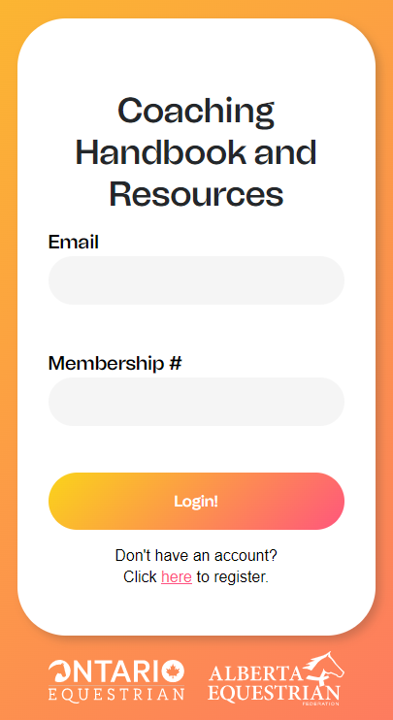
EC NCCP Training & Certification Options
You can find coach training:
ECampus – Online, virtual and in-person classes are continually added for each context of certification
Online Cohorts – Through OE, you can join a cohort for:
  Instructor (English/Western)
  Competition Coach (English/Western)
  Competition Coach Specialist (English – Annually beginning in January)
Through EC, you can join a cohort for:
  Competition Development (HP1 – Annually, Registration closes soon)
OE’s Coaching Handbook and Resources (C.H.A.R.) platform – Free for OE members to work through training and evaluation online at their own pace. www.equestriancoach.ca

Slide 20
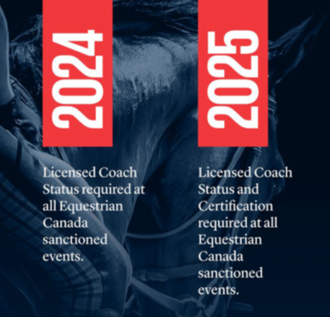
2025 Competition Requirements for Coaches
Licensed Coach Status required at all EC sanctioned events (Bronze, Silver, Gold and Platinum).
Temporary Coach Status fee will increase and will end at the end of 2025.
Certification Exemption Fee will increase, years of experience to qualify will also increase to 25 years and PD requirements added.
EC and PTSOs collaborate to deliver NCCP programming and support coaches getting certified.

Slide 21
How can OE Help?
Visit our events calendar to identify upcoming training opportunities appropriate for your certification pathway.
Make sure you are following us on Facebook (Ontario Equestrian) and Instagram @ONequestrian
Are you receiving our monthly eblasts? If not, contact us at info@ontarioequestrian.ca to be added to our mailing list
Register for a free C.H.A.R. Account: www.equestriancoach.ca
Complete your rider levels with our new Rider 8 for Professionals simplified evaluation process.
Remember, being a member includes access to the OE team. Don’t hesitate to reach out. We are here to support your experience.

Slide 22
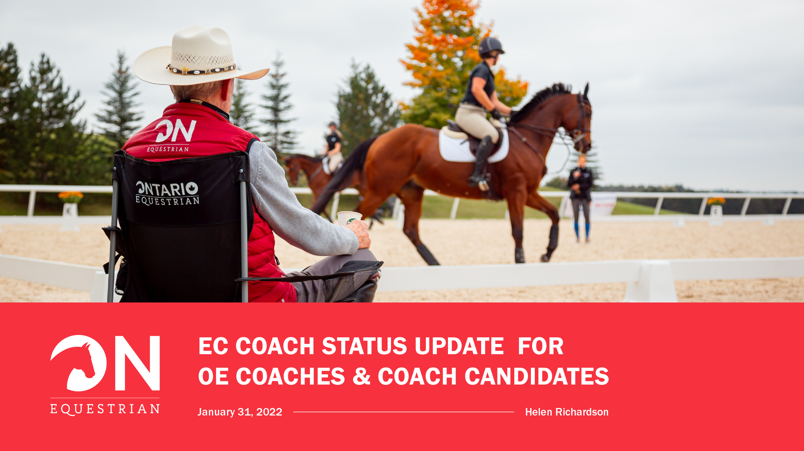
info@ontarioequestrian.ca
Notes:
Questions?

